Slide 1
Materials Science and Engineering
Dr. Ranjit Kumar
Department of Chemical Engineering
Email: ranjit.kumar@snu.edu.in

Slide 2
Syllabus
Chapter-1: Introduction
Material science and engineering, classification of engineering materials, structure-property relationship, bonding forces and energies, equilibrium and kinetics, stability and meta-stability, basic thermodynamic functions, entropy, kinetics of thermally activated processes
Chapter-2: Crystal Geometry and Structure Determination
Geometry of crystal, space lattice, crystal structure, crystal directions and planes, structure determination by x-ray diffraction, atomic structure and chemical bonding
Chapter-3: Crystal Imperfections
Defects in materials, point defects, dislocations, properties of dislocations, dislocation theory surface imperfections
Chapter-4: Phase Diagrams
The phase rule, single-component systems, binary-phase diagrams, iron-carbon phase diagram, microstructural changes during cooling, the lever rule.

Slide 3
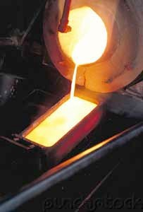
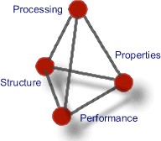
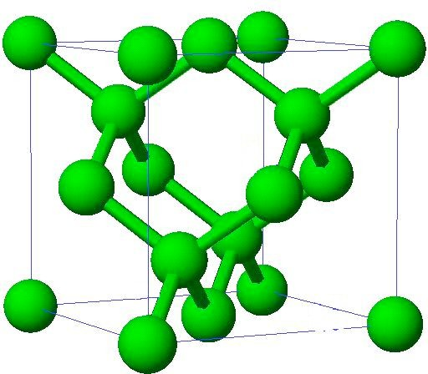
What is Materials Science and Engineering?
An interdisciplinary field that addresses the fundamental relationship between the Processing, Structure and Properties of materials and develops them for the desired technological applications (Performance)

Slide 4
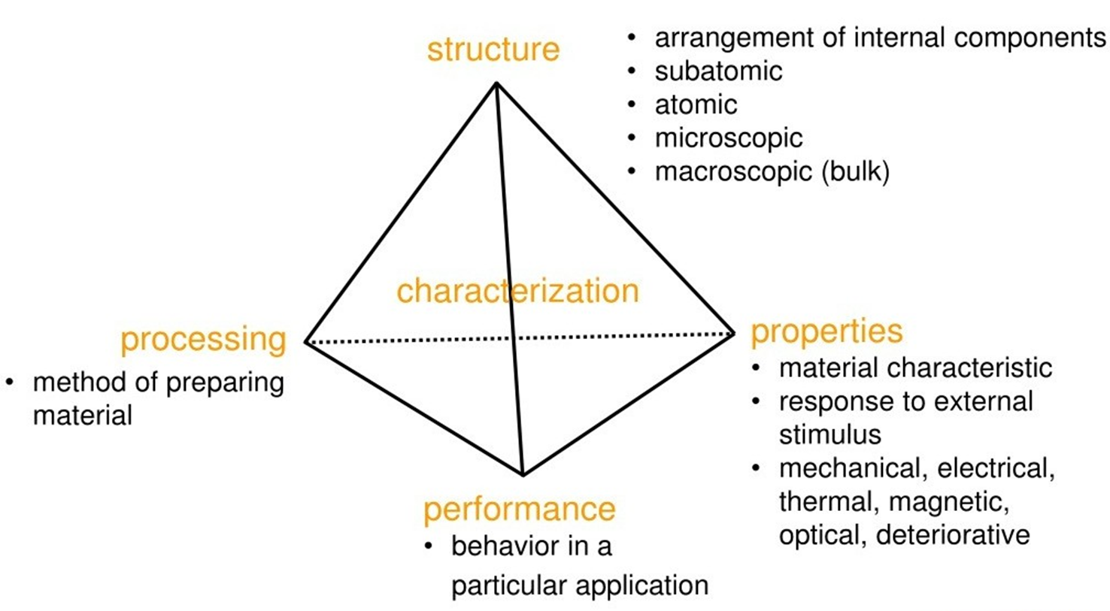
Materials Science and Engineering

Slide 5
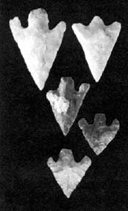
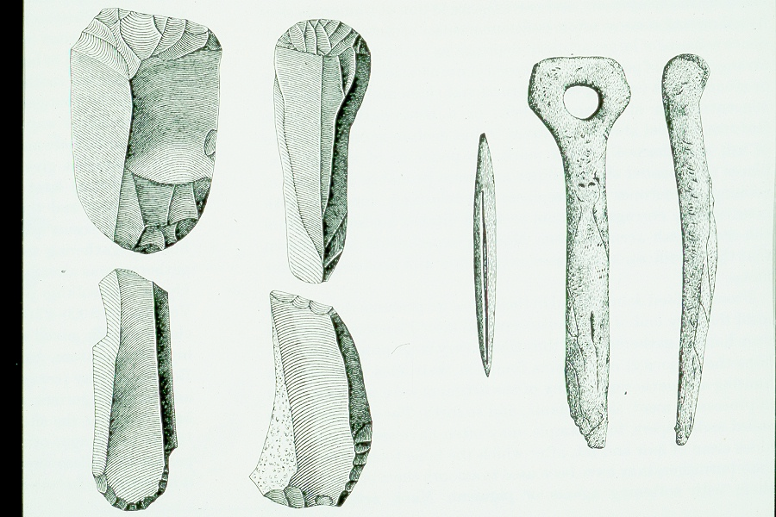
Materials through the ages
Stone Age (beginning of life – 3000 BC)
Feature: Using naturally occurring materials with only changes in shape

Slide 6

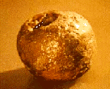
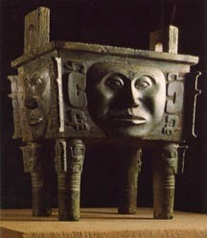
Materials through the ages
Bronze Age (3000 BC – 1200 BC)
Copper and Tin alloy
Ability to modify materials by refining (using heat), chemical modifications (alloying) and mechanical deformation (cold working)

Slide 7
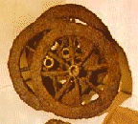
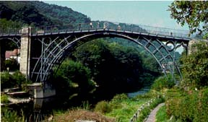
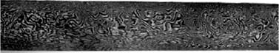
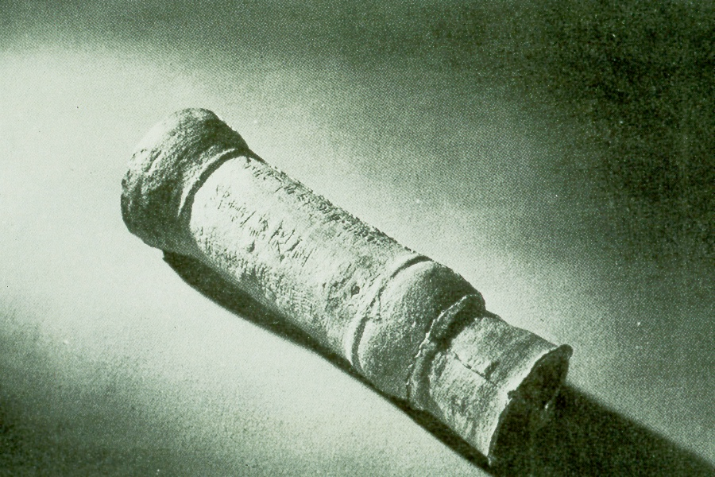
Materials through the ages
Iron Age (1200 BC – Present)
Casting and alloying wasn’t perfected until 16th century
Mastery of Steel (Iron alloy) technology enabled Industrial Revolution in the 18th and 19th century
Ability to heat treat at high temperature, control microstructure at different length scale and ability to design specific microstructures for specific properties

Slide 8


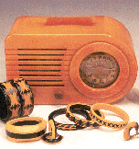

Materials through the ages
Plastic Age (1940 - Present)
Discovery of polymers, and the ability to synthesize and process polymers.

Slide 9

Materials through the ages
Silicon Age (1950 - Present)
Commercialization of silicon technology (integrated circuits, electronic devices, etc…) led to the information age, which gave a boost to human productivity
Ability to control alloying accurately, ability to make thin films
7

Slide 10
Computational Materials Science
Computational materials science (CMS) is a field that uses computers to study the properties and structures of materials, and how they relate to processing conditions. It uses physical modeling, machine learning, and theoretical models to understand the relationships between material structure and properties. CMS can be used for many purposes, including:
CMS can help researchers discover new materials and investigate existing inorganic materials, such as metals.
CMS can be used to improve the properties of materials, such as piezoelectric smart materials, which can convert mechanical energy into electrical energy.
CMS can help researchers explain experiments and explore materials theories.
Advances in computing power and software allow researchers to design, synthesize, characterize, and test materials in a virtual setting.

Slide 11
Computational Materials Applications
Properties of materials are not only determined by their respective chemical composition, but also to a large degree by their microstructure. Studying the interrelation between processing, structure and properties of materials is thus at the heart of materials science.
The often competing, complex mechanisms take place on a range of different length- and time scales, requiring the development of new simulation methods suitable for scale-bridging.
The investigation of crystal and defect properties for example, requires quantum mechanical calculations and atomistic simulation methods with typical time scales ranging from femtoseconds through nanoseconds and length scales ranging from Angströms to several hundred nanometers.
Studying the interactions, statistics and self-organization of lattice defects.
Predicting microstructure information, which are used in the design of engineering structures and devices.

Slide 12
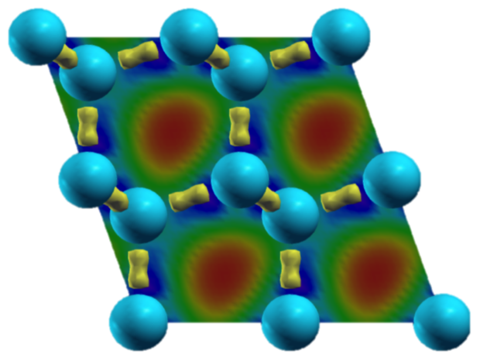
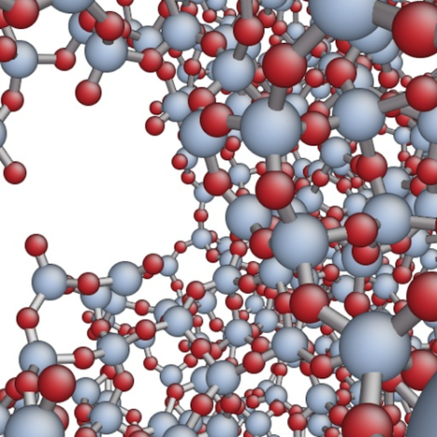
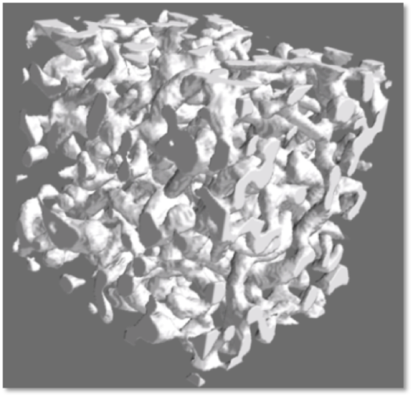
Some examples of simulation
Charge density distribution in a silicon crystal
Crack in a silicate glass
Simulation of an experimental foam structure with very high porosity

Slide 13
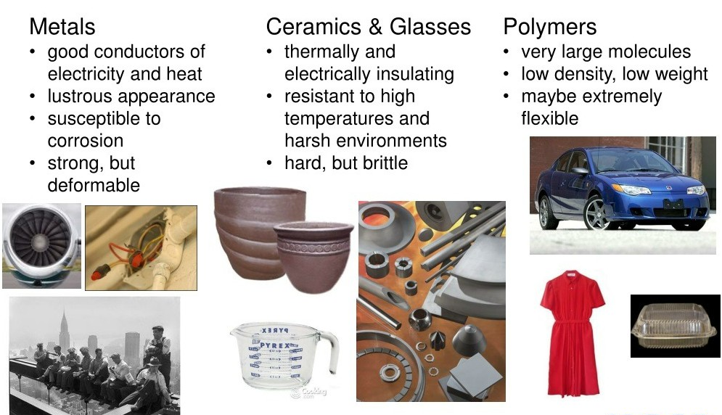
Classification of Materials

Slide 14
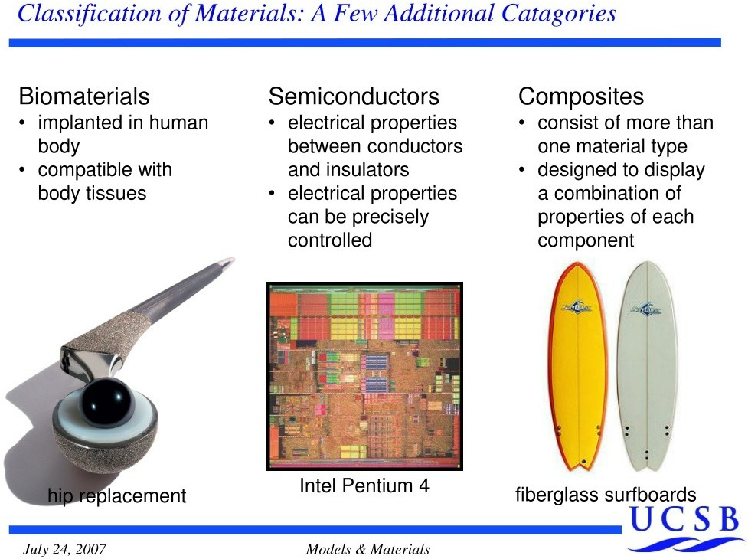
A Few Additional Categories

Slide 15
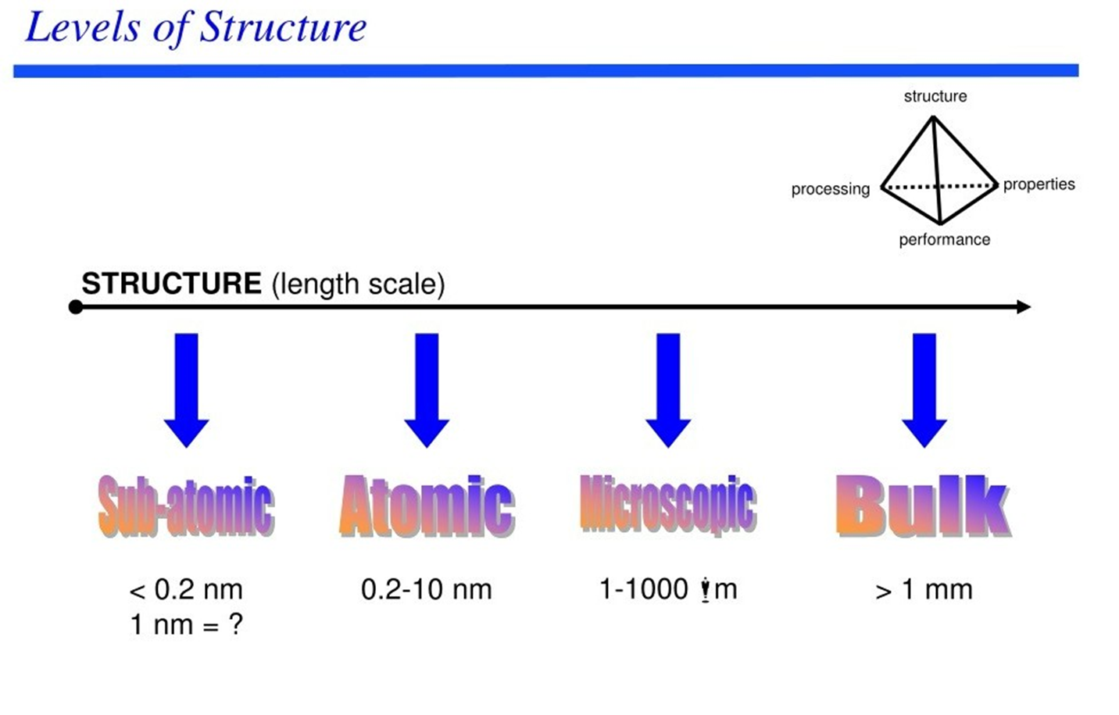

Slide 16
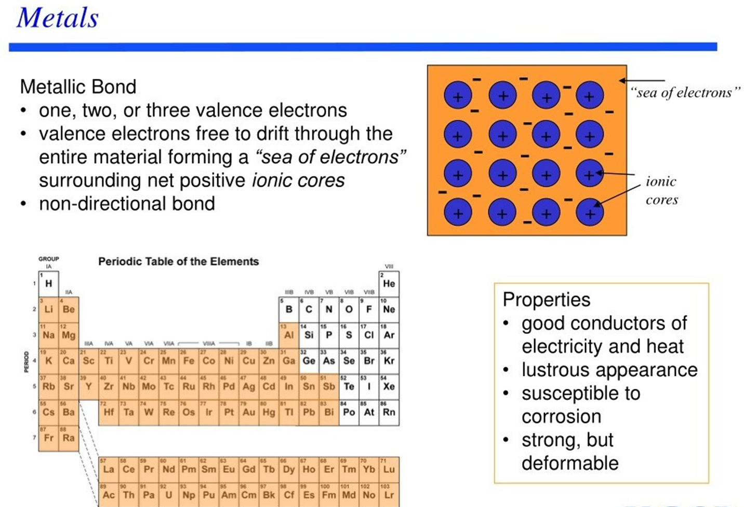

Slide 17
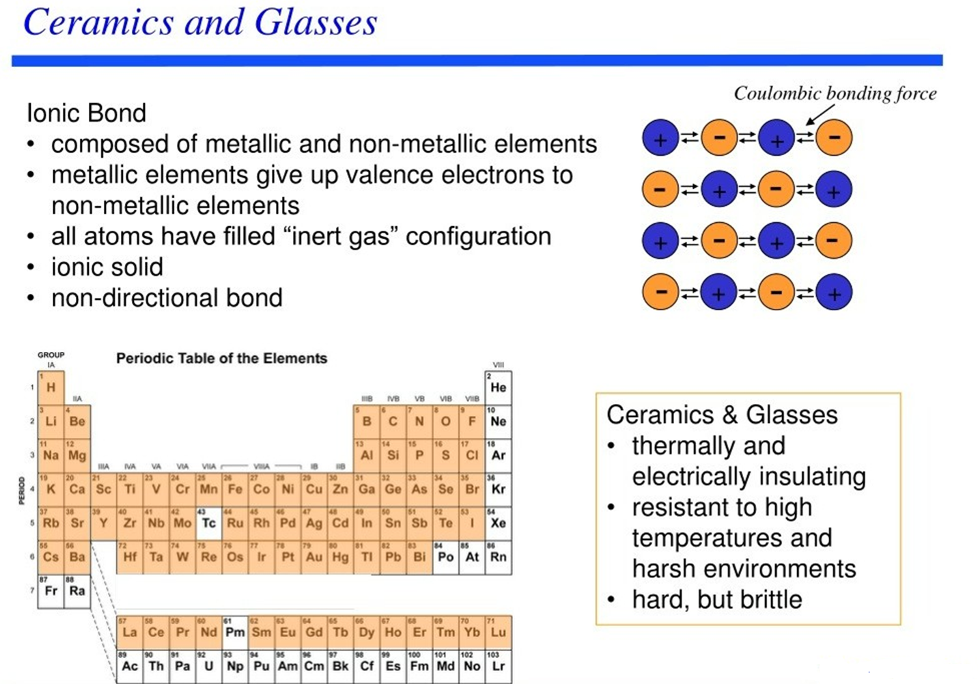

Slide 18
